Slide 1
Modern Development tools
A Intro to Bash, Conda, Git and VS code
Daniel Hintz
M.S. Candidate in Statistics
University of Wyoming
dhintz1@uwyo.edu

Slide 2
Plan
Bash
Linux background
WSL
Conda
Git
VScode

Slide 3
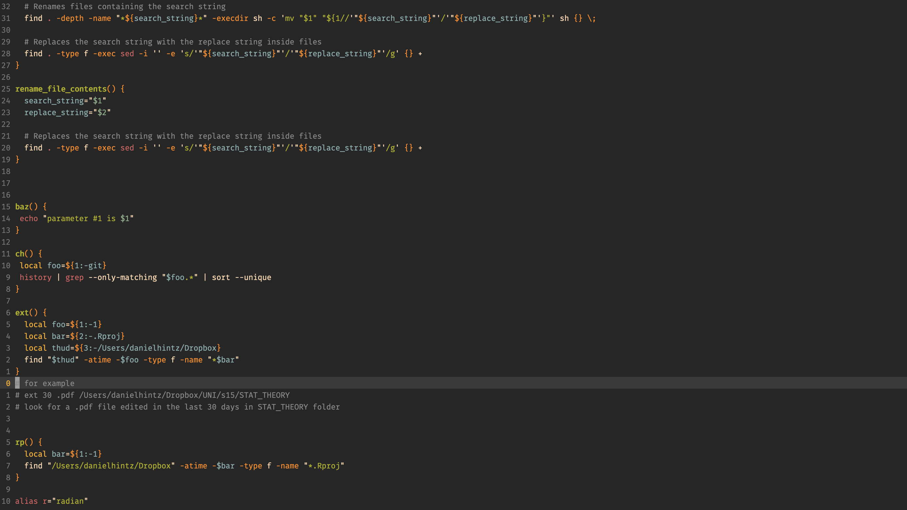
Bash

Slide 4
Bash
It’s the coding language we use to drive around on our computer
It is not a scientific programming language in the sense that bash is not typically used for modeling and scientific computing
Instead, bash enables scientific computing

Slide 5
Why should anyone learn bash?
Reproducibility
Access tools like conda, git, docker, etc
Collaboration
A Reproducible workflow enables streamlined collaboration
Because there is no other way
You are working on a cluster (don’t have a GUI)
Your advisor, PI, team, or Boss has a reproducible workflow using bash, which demands you to use bash also.
Notes:
Collaboration

Slide 6
But Before we learn more about bash, we must first take a couple of steps back

Slide 7
Linux and Linux distributions
Linux is an operating system (OS), in the same way Mac and Microsoft Windows are both operating systems.

Slide 8
What is a distribution
“An operating system compiled from components developed by various open source projects and programmers. Each distribution includes the Linux kernel (the foundation of the operating system), the GNU shell utilities (the terminal interface and commands), the X server (for a graphical desktop), the desktop environment, a package management system, an installer and other services.”
So, to make a metaphor, if an OS is a language, a distribution is like a dialect of that language.

Slide 9
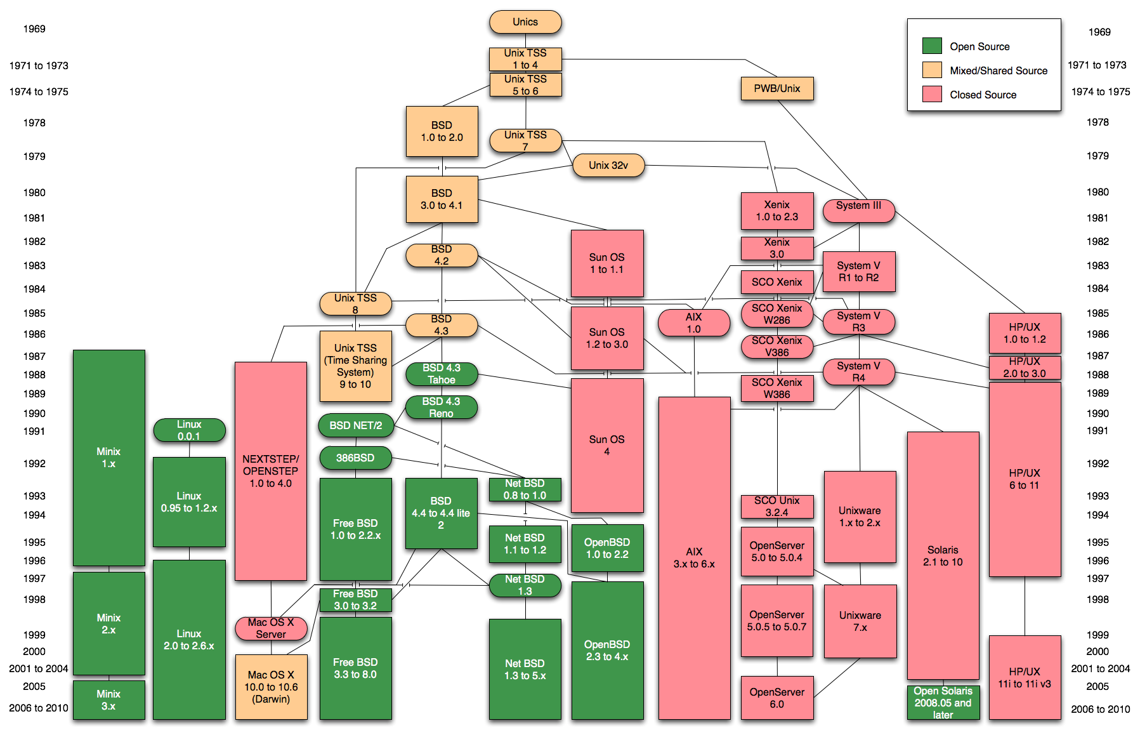
Unix and its look-alikes
Notes:
Notice Windows is no where on this tree

Slide 10
Kernal
The Linux kernel is the main component of a Linux operating system (OS) and is the core interface between a computer’s hardware and its processes. It communicates between the two, managing resources as efficiently as possible.
The kernel is so named because—like a seed inside a hard shell—it exists within the OS and controls all the major functions of the hardware, whether it’s a phone, laptop, server, or any other kind of computer.
The kernel is the heart of any operating system.

Slide 11
shells
A shell is a program that acts as an interface between a user and the kernel. It allows a user to give commands to the kernel and receive responses from it.
There are many different Linux shells, and think of each as a coding language
Some common shell languages include:
Bash
Csh
Zsh
Ksh
Fish

Slide 12
WSL 2
WSL is a compatibility layer that allows you to use a full Linux command-line environment directly on Windows
To install WSL 2 on Windows 10, you need the minimum:
Windows 10 May 2020 (2004), Windows 10 May 2019 (1903), or Windows 10 November 2019 (1909)
As opposed to previous WSL versions, WSL 2 has a real Linux kernel for the first time (released in 2017)
Hence, there are less incompatibility issues
If you plan are going to use bash on your Windows computer frequently, it would be worth setting up a dual-boot system with a Linux distribution (there’s lots of YouTube tutorials to do this).

Slide 13
Let’s get up and running
Now, we will walk through Installing WSL for Windows computers
Steps:
1. Navigate to Windows PowerShell, run the following
2. wsl.exe --install
3. sudo apt update && sudo apt upgrade
Your home directory will be at /mnt/c/Users/<your_username>/

Slide 14
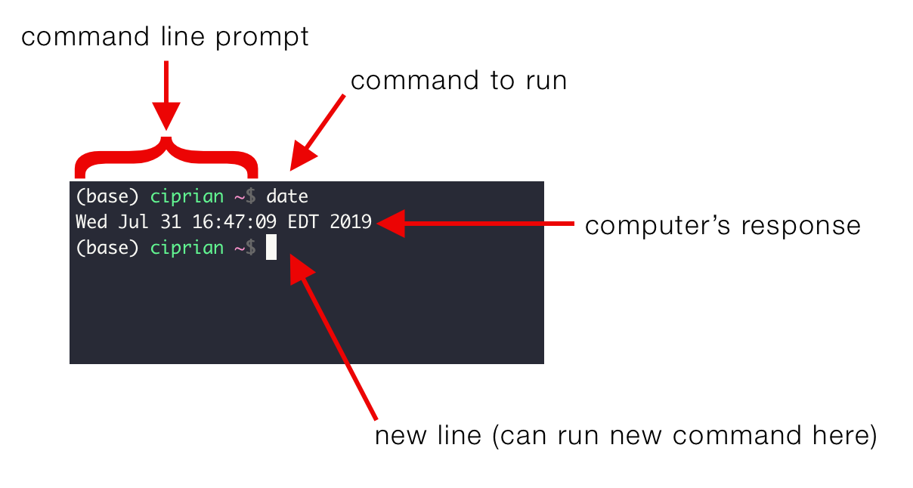
What is the command line?

Slide 15
Let’s practice some commands

Slide 16
Common Commands
pwd
mv
which
clear
pip
grep
awk
tree
realpath
tldr
ref
find
Rscript
mkdir
vim
vi
ls
conda
cat
Cd
vim
vi
ls
conda
cat
cd
git
Open (mac only)
source
rm
brew
history
sudo
echo
man
bash
python
sudo apt install package_name
Notes:
xdg-open # for non wsl linux only

Slide 17
Installing software mAC vs linux
Linux/windows with wsl
sudo apt install package_name
Mac
# installing brew
/bin/bash -c "$(curl -fsSL https://raw.githubusercontent.com/Homebrew/install/HEAD/install.sh)"
brew install package_name

Slide 18
Conda
Conda is an open-source package and environment management system.
While it is compatible with multiple languages, it is primarily used with Python.
It simplifies the process of package installation and version control for seamless project development.

Slide 19
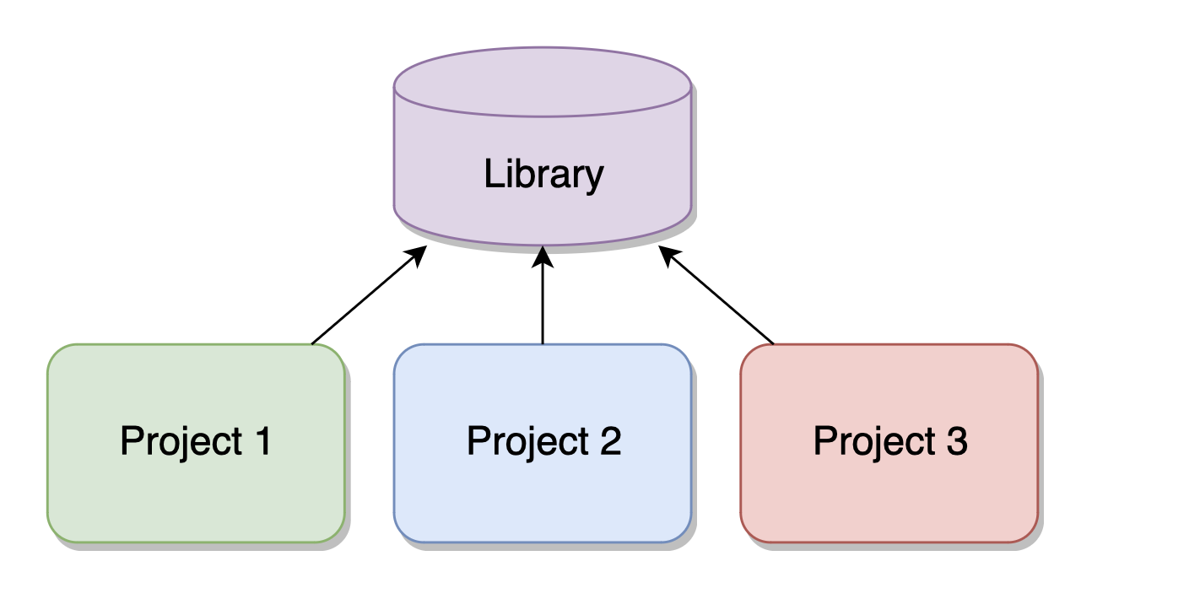
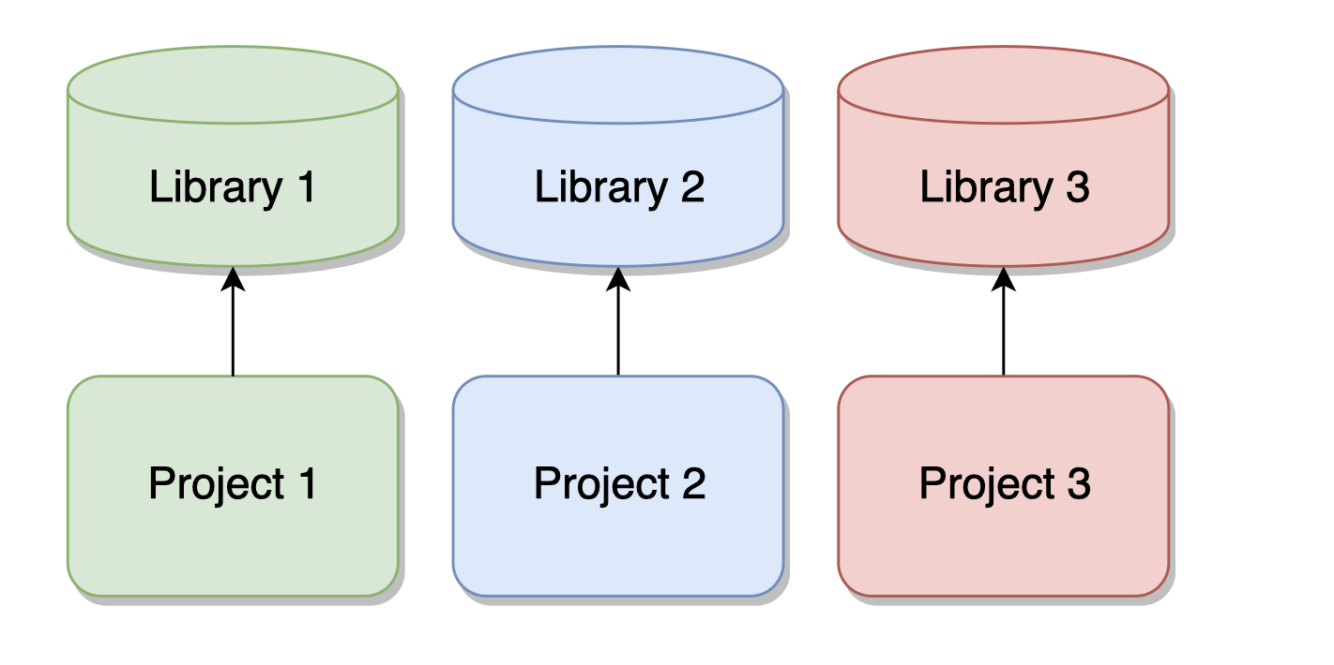
Without using Conda
Manages both Python and R libraries, aiding in resolving cross-language dependency issues
Cross-platform compatibility, functioning on Windows, macOS, and Linux
Facilitates the creation of isolated environments for different projects or versions of Python, ensuring no conflicts between dependencies
With Conda

Slide 20
Why Use Conda
Streamlines the installation of complex data science packages like NumPy, SciPy, and TensorFlow
Automatically manages package dependencies, avoiding the 'dependency hell'
Reduces compatibility issues, ensuring that 'it works on my machine' is a phrase of the past
Assures consistency across development, testing, and production environments
Improves collaboration and sharing by allowing easy export and replication of environments

Slide 21
Conda installation
Mac
Navigate to https://docs.conda.io/projects/miniconda/en/latest/index.html
Install Miniconda3 macOS Intel x86 64-bit pkg , open and follow prompts
Windows (wsl) /Linux
wget https://repo.anaconda.com/miniconda/Miniconda3-latest-Linux-x86_64.sh # For Miniconda
chmod +x Miniconda3-latest-Linux-x86_64.sh
bash ./Miniconda3-latest-Linux-x86_64.sh
nano ~/.bashrc
Add
export PATH="$HOME/miniconda3/bin:$PATH”
to ~/.bashrc

Slide 22
Main conda commands
conda create –n env_name package_name
conda install –c channel_name package_name
conda activate -n env_name
conda activate env_path
conda info –envs
conda list
conda env export > environment.yml
conda env create -f environment.yml

Slide 23
R test in conda
conda create -n r_test
conda activate r_test
conda install -c r r r-essentials
R
R$> .libPaths()
R$> list.files(.libPaths())

Slide 24
Installing git
Linux/Windows
sudo apt-get install git
Mac
brew install git

Slide 25
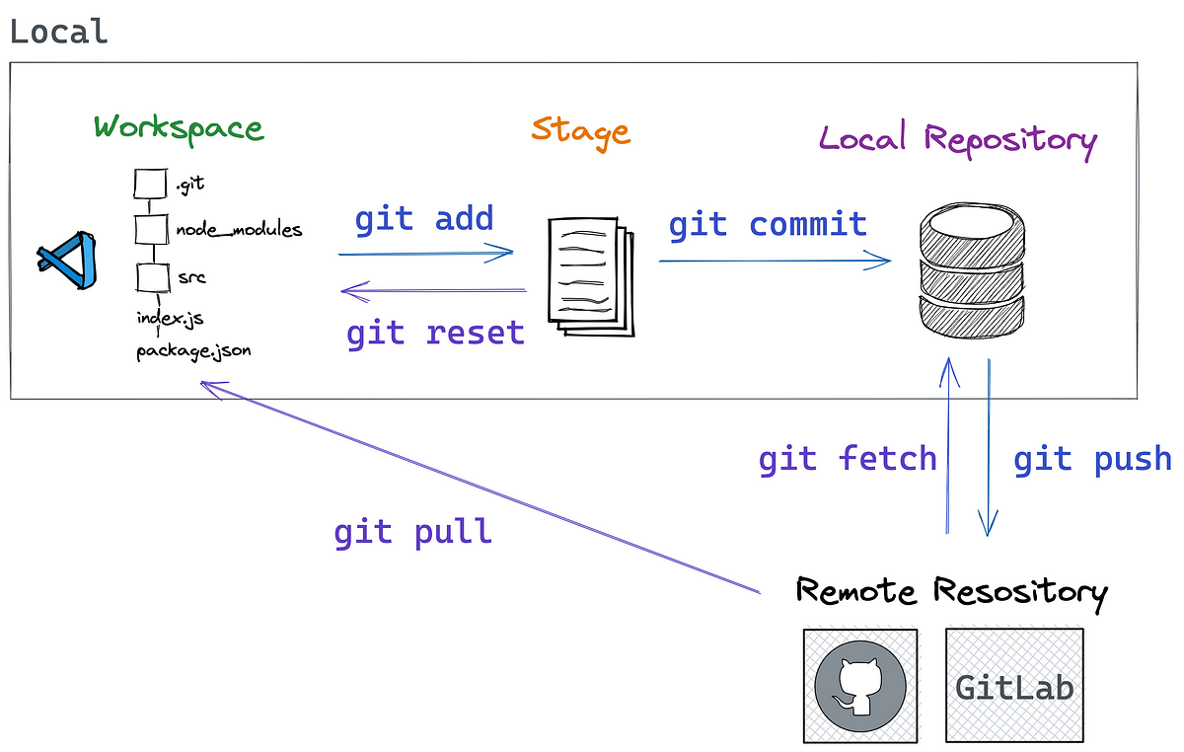
Why use git

Slide 26
Why use git
Version Control:
Git enables precise version control of statistical analysis scripts, datasets, and research papers, allowing statisticians to track and manage changes over time.
It's invaluable for reviewing the evolution of analysis and can help in reverting to previous versions if needed.
Collaboration:
Git facilitates collaboration with other statisticians and researchers, making it easier to work on joint projects.
Changes by different team members can be merged, reviewed, and integrated efficiently.
Experiment Tracking:
Git allows statisticians to branch out different versions of their analysis, enabling parallel experimentation without affecting the main analysis.
It's useful for testing new statistical methods or models while maintaining the integrity of the original work.
Reproducibility:
Maintaining a Git repository with all versions of code and data processing steps enhances the reproducibility of statistical analyses.
This is crucial in academic and scientific research where reproducibility is a key requirement.
Backup and Restore:
Git provides a backup of the entire project history, which can be crucial if there are issues with local files or hardware.
This also enables statisticians to work from different machines or locations without losing their work.

Slide 27
Why use git
Documentation:
Git commits encourage documenting changes and rationale, which is a good practice in statistical analysis.
This documentation is valuable for future reference or when sharing work with others.
Error Tracking and Resolution:
Git helps in tracking down when and how errors were introduced into the analysis or codebase, aiding in quicker resolution.
Integration with Other Tools:
Git integrates well with various statistical and data analysis tools and platforms, streamlining the workflow.
Many integrated development environments (IDEs) used for statistical programming, like RStudio, support Git.
Open-Source Contribution:
For statisticians involved in developing open-source statistical methods or software, Git is often the standard tool for managing contributions.
Portfolio Development:
Maintaining a Git repository, especially on platforms like GitHub, can serve as a portfolio of a statistician’s work, showcasing skills and projects to potential employers or collaborators.

Slide 28
git
# copy remote file to local machine
Git clone <ssh_key>
git status # see if there are changes are no committed
git checkout -b <new-branch-name> # check out development branches
# now on dev branch make changes then add, commit, pull, merge and push changes
git add . # add changes
git commit -m “message” # commit changes
# ensure your local branch is up-to-date with the remote branch
git pull origin main #Pull the Latest Changes from Remote
# Switch back to your main branch
git checkout main
git merge [new-branch-name]
git push origin main

Slide 29
VScode
Google Visual Studio code and install
Install extension REditorSupport
Go to REditorSupport extension settings and change Rpath <OS> and Rterm: <OS> to the path of R exectuble
I.e., can get path from R using
file.path(R.home(), "bin", "R")
Now lets open the file dummy_R_code.R in vscode

Slide 30
Thank you

